Slide 1
General NLP Classification with Neural Network
Summer 2022, Boston University

Slide 2

Classification
Spam Email
Hate Speech
Sarcasm
Observation → Text Cleaning → Observation → Tokenization → Word Embedding → Model

Slide 3
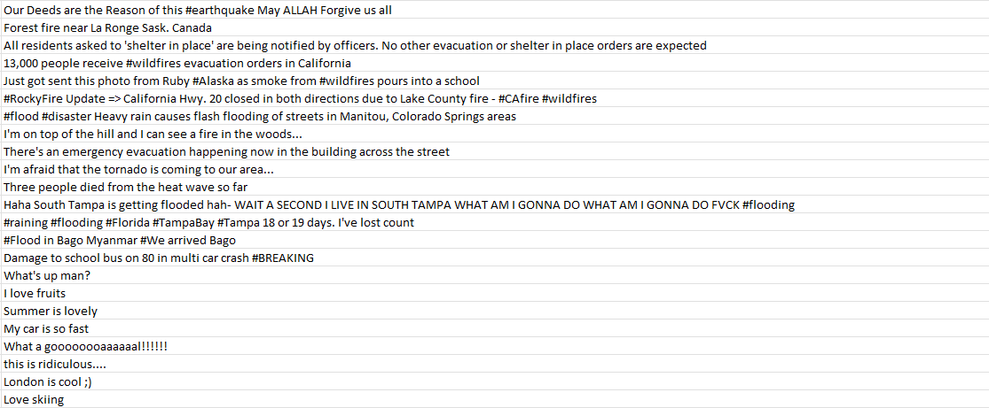
Early Observation

Slide 4
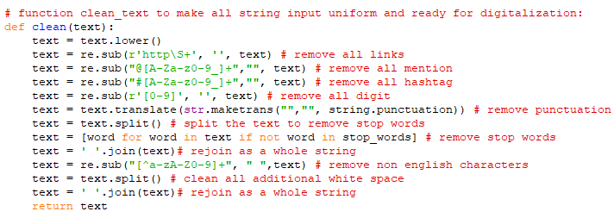
Text Cleaning

Slide 5
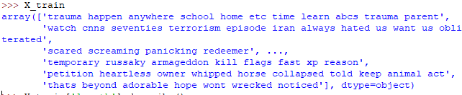
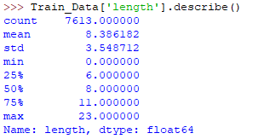
Afterward Observation

Slide 6
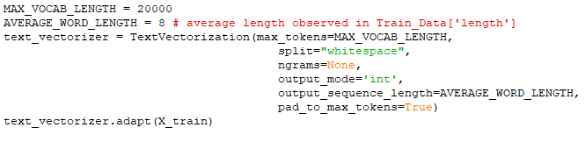

Tokenization

Slide 7
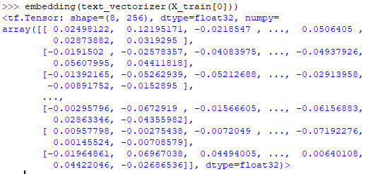
Word Embedding

Slide 8
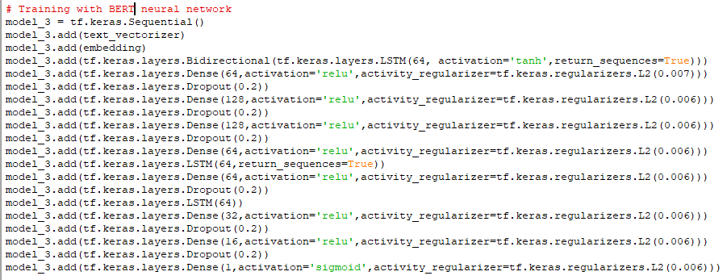
Model

Slide 9
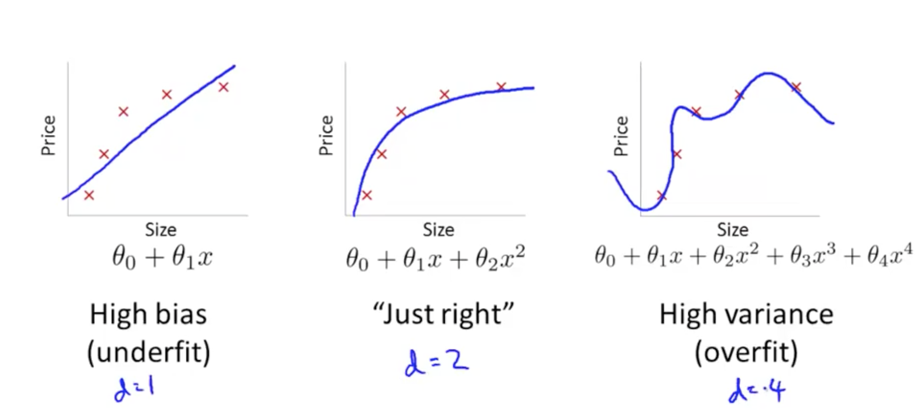
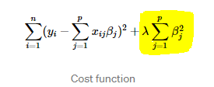
Overfitting
Adding more data
Removing some features
Applying Regularization

Slide 10
Future work
Feature Extraction
Better Embedding model

